Slide 1
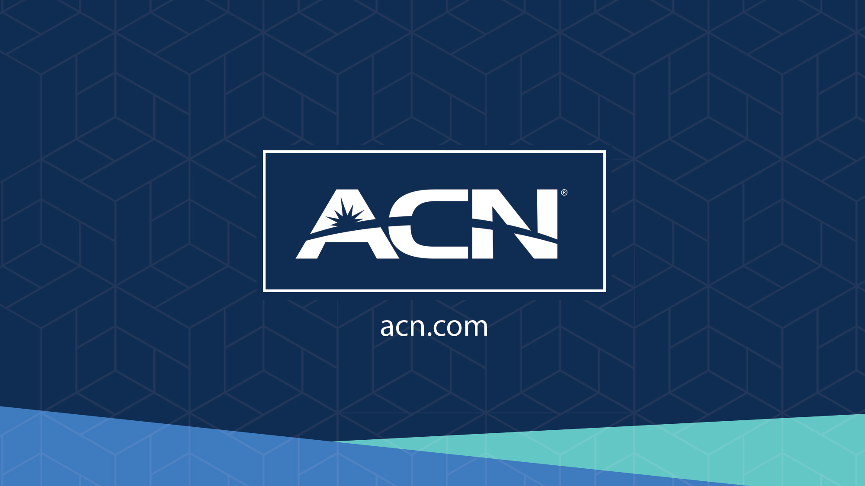


Slide 2
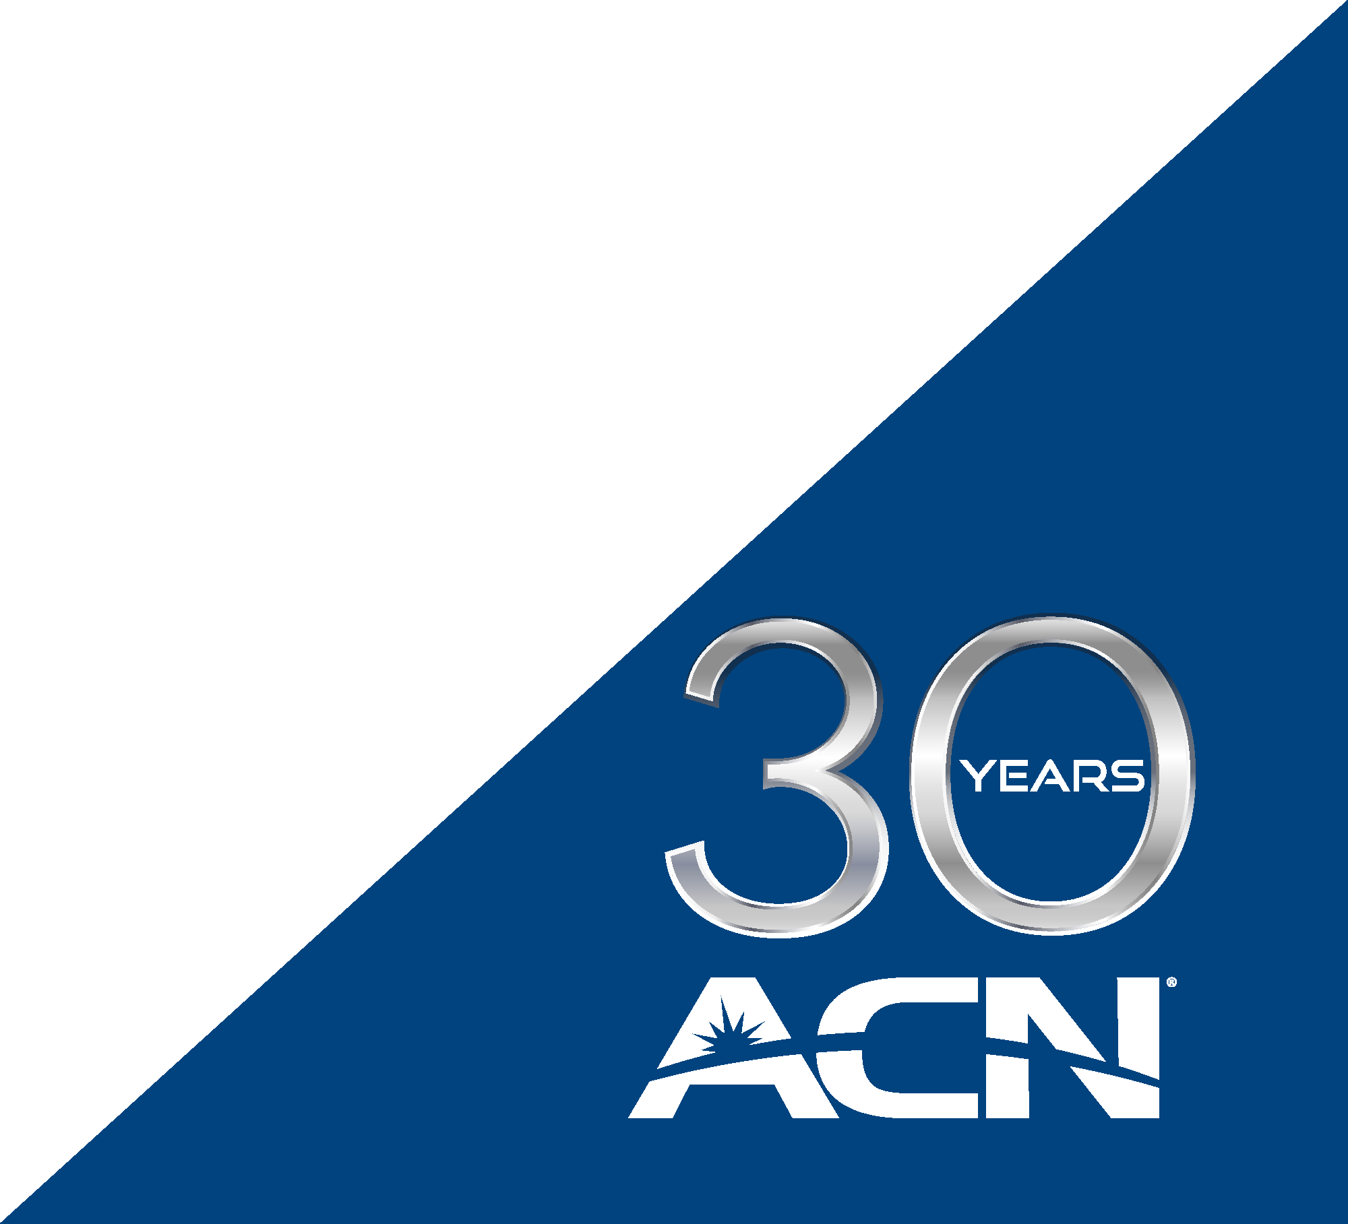
Refer to the ACN Compensation Plan for complete details. Earnings as an ACN IBO are based solely upon the successful sale of products to customers and their usage of those products. Individuals will incur expenses in operating their ACN business, such as the sign-up and monthly business support fees, as well as other possible operating expenses. As with any business, earnings and success at ACN are not guaranteed but depend primarily on the individual’s persistence, effort and results of acquiring customers personally and/or through their team. Individuals will not earn income and will lose money as an IBO if customers are not acquired.

Slide 3






1
COMPANY
An Established Track Record
Service Provider Specializing in Customer Acquisition
Started
in the U.S.
January 1993
27 Countries,
5 Continents
Millions of Customers Acquired
Billions
in Sales

Slide 4

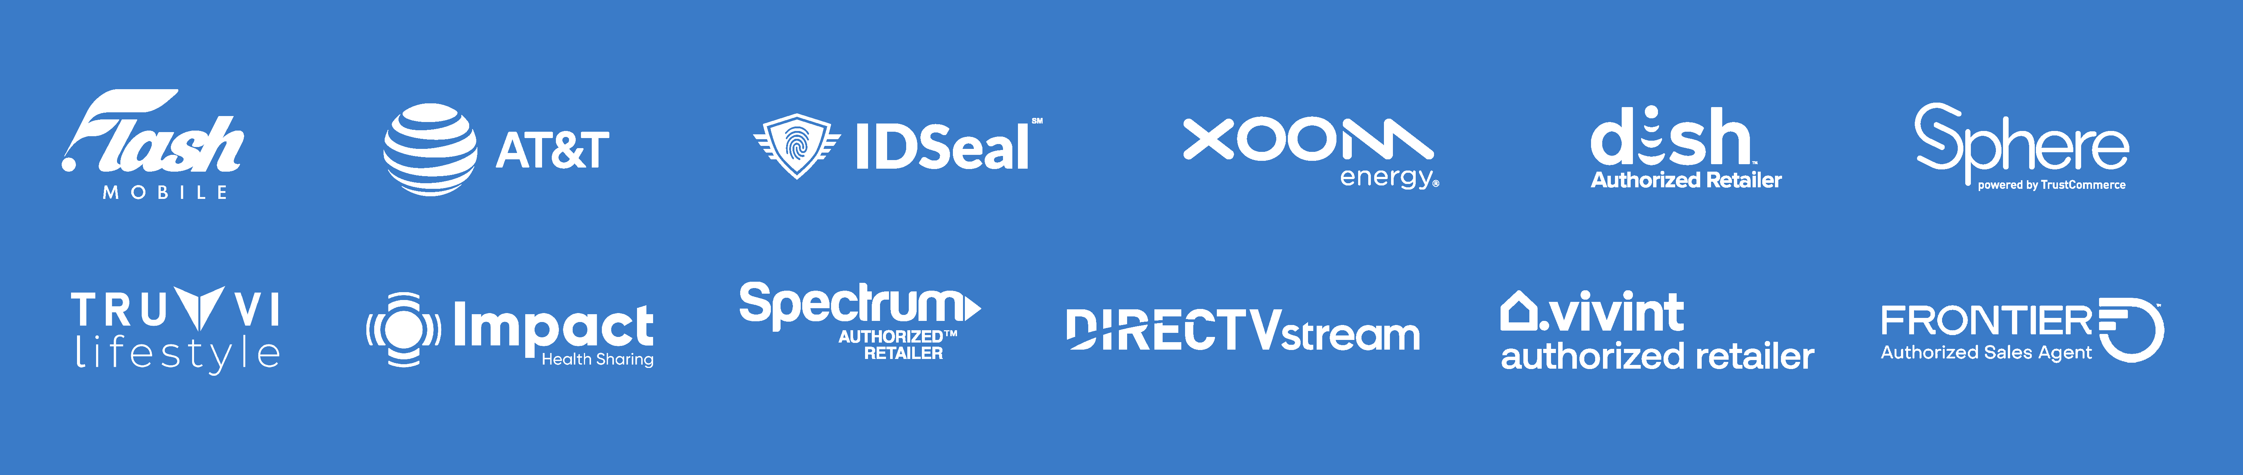














2
ESSENTIAL SERVICES
Business Residential
WHEN A CUSTOMER IS ACQUIRED,
A CHILD IS FED.

Slide 5



EARN BONUSES TO COVER YOUR SERVICES
Refer-a-Friend
PowerUP
Refer-a-Friend
Refer 12+ XOOM Energy Residential
Natural Gas or 12+ XOOM Energy Electricity customers and receive a bonus equal to the average commodity-only charges of your customers’ bills.
Enroll & authenticate 5+ customers with an IDSeal Annual plan and receive a bonus equal to the cost of your Annual service.*
Refer 5+ Flash Mobile customers and earn a FREE* line of service.
IMAGINE HOW MUCH YOU CAN SAVE YEAR AFTER YEAR!
*Excludes taxes and surcharges. Terms and conditions apply.

Slide 6





3
OUR BUSINESS MODEL
Most Service Providers
Media & Internet Marketing
CUSTOMERS

Slide 7




3
OUR BUSINESS MODEL
What Makes us Different?
Most Service Providers
More Choices for Consumers
Media & Internet Marketing
YOU
Income Generating Opportunity for you
CUSTOMERS

Slide 8






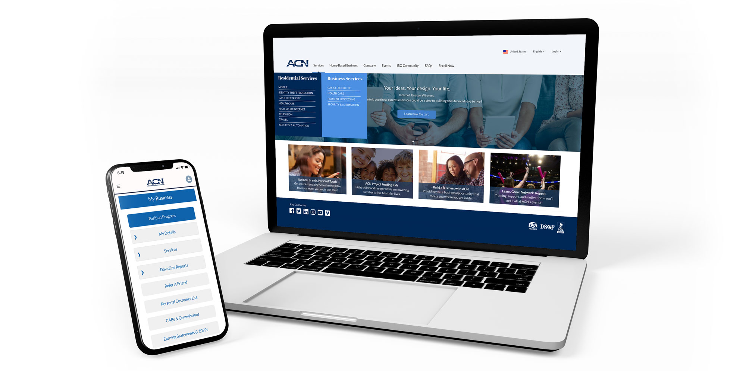
4
Become an Independent Business Owner (IBO)
$299 Start-Up + $25/month Business Support
Personalized Website
Training
& Marketing
Tools
Business Tracking
& Reporting on the
Salesforce Platform
IBO &
Customer
Support
Exclusive IBO Savings & Rebates

Slide 9

4
Become an Independent Business Owner (IBO)
$299 Start-Up + $25/month Business Support
Personalized Website
Training
& Marketing
Tools
Business Tracking
& Reporting on the
Salesforce Platform
IBO &
Customer
Support
Exclusive IBO Savings & Rebates
All you have to do:
Direct people
to your website
DOES THE REST!
Assist them in becoming customers

Slide 10
5
Personal Income
Your Customers
Monthly Customer Bonuses
Acquire Customers Totaling:
5 Services = $200
8 Services = $400
11 Services = $600
Plus $200
for Every Additional 3 Services
Paid weekly as earned when YOU acquire customers.*
*Refer to the ACN Compensation Plan for complete details!

Slide 11
5
Personal Income
Your Customers
Monthly Customer Bonuses
Residual Income
Acquire Customers Totaling:
3% TO 20%
Monthly Commissionable Revenue*
5 Services = $200
8 Services = $400
11 Services = $600
Plus $200
for Every Additional 3 Services
Paid monthly on your customers Monthly Commissionable Revenue*
Paid weekly as earned when YOU acquire customers.*
*Refer to the ACN Compensation Plan for complete details!

Slide 12
6
Overriding Income
Your Team’s Customers
Customer Acquisition
Bonuses (CABs)
$50 - $450
Paid weekly as earned when your TEAM acquires customers.*
*Refer to the ACN Compensation Plan for complete details!

Slide 13
6
Overriding Income
Your Team’s Customers
Customer Acquisition
Bonuses (CABs)
Residual Income
$50 - $450
4%
Paid weekly as earned when your TEAM acquires customers.*
Paid monthly on your TEAM’s customers Monthly Commissionable Revenue*
*Refer to the ACN Compensation Plan for complete details!

Slide 14

7
IBO Earned Positions
Increasing CABs
Reaching higher earned positions is based on the number of personal and team customers.*
Incentive Trips
Increased Residual
CABs increase as you move up earned positions.
*Refer to the ACN Compensation Plan for complete details!

Slide 15




8
Training & Support
Online
Presentations & Trainings
Your Team’s
In-Person & Virtual Events
In-Person
&
Training Events
IN BUSINESS FOR YOURSELF, NEVER BY YOURSELF
Notes:
With an opportunity that offers so much and appears so simple, it’s important to understand that no matter how good an opportunity is, you have to do the right things to get the right results, and that is why ACN believes so strongly in providing the very best training and support possible.
We offer comprehensive online training on exactly how to build your business. In addition, we also offer live IN-PERSON and VIRTUAL training events. With ACN, you may be in business for yourself, but never by yourself. If you're a success, we're a success.

Slide 16
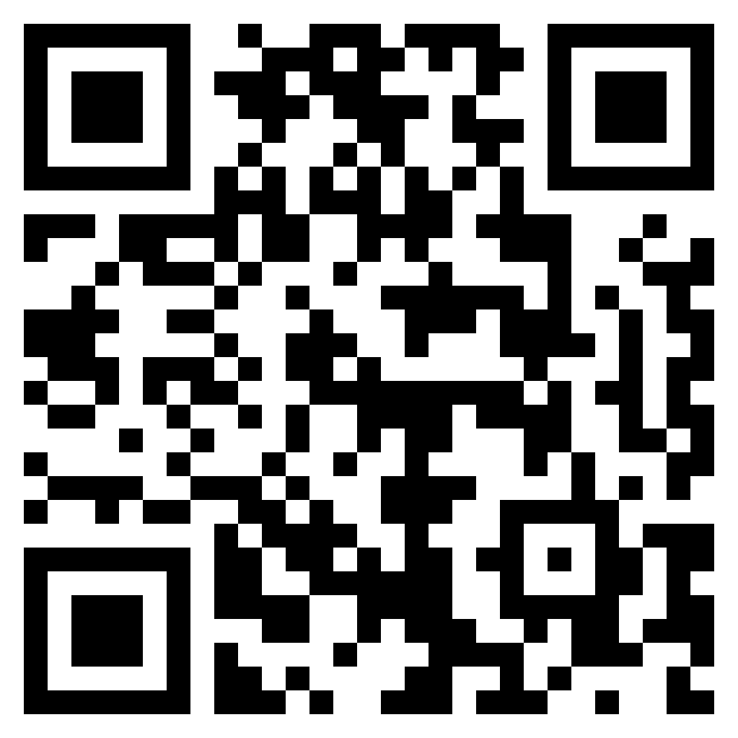
8
Training & Support
NEXT STEPS
Enroll as an IBO
Utilize Support System
Participate in Training
Acquire Customers
Get with the person who showed you this presentation and they’ll send you a link to their website OR scan the QR code and input the IBO’s number.

